Slide 1
Information Security
Dr. Zia ur Rehman

Slide 2
Books
Stallings, W. (2022). Cryptography and network security: principles and practice. Pearson. ISBN: 9789332585225.
Maymi, F., & Harris, S. (2016). CISSP All-in-One Exam Guide, 7 th Edition. McGraw-Hill Education. ISBN: 9780071849272.

Slide 3
Your Best Strategy
Come to every lectures
Read every lecture after going home and prepare it well.
Do not wait till last minute to prepare for exam or work on projects
Enjoy the fun!

Slide 4
Lectures need your help!
Ask questions
Make suggestions!
Read something interesting and relevant to this course? Announce it in class!

Slide 5
Cyber Security
It is the protection of information that is stored, transmitted, and processed in a networked system of computers, other digital devices, and network devices and transmission lines, including the Internet.

Slide 6
Reader’s Guide
The art of war teaches us to rely not on the likelihood of the enemy's not coming, but on our own readiness to receive him; not on the chance of his not attacking, but rather on the fact that we have made our position unassailable. —The Art of War, Sun Tzu

Slide 7
Cyber Security….
As subsets of cybersecurity, we can define the following:
Information security: This term refers to preservation of confidentiality, integrity, and availability of information. In addition, other properties, such as authenticity, accountability, nonrepudiation, and reliability can also be involved.
Notes:
Nonrepudiation: Assurance that the sender of information is provided with proof of delivery and the recipient is provided with proof of the sender's identity, so neither can later deny having processed the information.

Slide 8
Definitions
Computer Security - generic name for the collection of tools designed to protect data and to thwart hackers
Network Security - measures to protect data during their transmission
Internet Security - measures to protect data during their transmission over a collection of interconnected networks
Notes:
Here are some key definitions, note boundaries between them are blurred.
Network Security: This term refers to protection of networks and their service from unauthorized modification, destruction, or disclosure, and provision of assurance that the network performs its critical functions correctly and there are no harmful side effects

Slide 9
Security Objectives
Confidentiality: This term covers two related concepts:
  Data Confidentiality: Assures that private or confidential information is not made available or disclosed to unauthorized individuals.
  Privacy: Assures that individuals control or influence what information related to them may be collected and stored and by whom and to whom that information may be disclosed.
Notes:
privacy is the right to be let alone, or freedom from interference or intrusion. Information privacy is the right to have some control over how your personal information is collected and used.

Slide 10
Security Objectives…
Integrity: This term covers two related concepts:
  Data integrity: Assures that data (both stored and in transmitted packets) and programs are changed only in a specified and authorized manner.
  System integrity: Assures that a system performs its intended function in an unimpaired manner, free from deliberate or inadvertent unauthorized manipulation of the system.

Slide 11
Sec. Obj.
Availability: Assures that systems work promptly and service is not denied to authorized users.

Slide 12
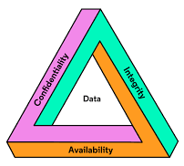
Sec.. Obj...
CIA Triad
Confidentiality
  (Account information)
Integrity
  (Patient's information)
Availability
  (Authentication service)
Notes:
Confidentiality: Preserving authorized restrictions on information access and disclosure, including means for protecting personal privacy and proprietary information.
Integrity: Guarding against improper information modification or destruction, including ensuring information nonrepudiation and authentic.
Availability: Ensuring timely and reliable access to and use of information.

Slide 13
Sec. Obj…
Authenticity: The property of being genuine and being able to be verified and trusted; confidence in the validity of a transmission, a message, or message originator.
Accountability: The security goal that generates the requirement for actions of an entity to be traced uniquely to that entity.
Notes:
truly secure systems are not yet an achievable goal, we must be able to trace a security breach to a responsible party.

Slide 14
Computer Security Challenges
not simple
must consider potential attacks.
procedures used counterintuitive
involve algorithms and secret info
must decide where to deploy mechanisms
battle of wits between attacker / admin
not perceived on benefit until fails
requires regular monitoring
too often an after-thought
regarded as impediment to using system

Slide 15

OSI Security Architecture
ITU-T X.800 “Security Architecture for OSI”
defines a systematic way of defining and providing security requirements
Notes:
To assess effectively the security needs of an organization and to evaluate and choose various security products and policies, the manager responsible for security needs some systematic way of defining the requirements for security and characterizing the approaches to satisfying those requirements. This is difficult enough in a centralized data processing environment; with the use of local and wide area networks,the problems are compounded. ITU-T Recommendation X.800, Security Architecture for OSI, defines such a systematic approach. The OSI security architecture is useful to managers as a way of organizing the task of providing security.
Threat: A potential for violation of security, which exists when there is a circumstance, capability, action, or event that could breach security and cause harm. That is, a threat is a possible
danger that might exploit a vulnerability.
Attack: An assault on system security that derives from an intelligent threat; that is, an intelligent act that is a deliberate attempt (especially in the sense of a method or technique) to evade security services.

Slide 16
Aspects of Security
consider 3 aspects of information security:
  security attack
  security mechanism
  security service
Notes:
The OSI security architecture focuses on security attacks,mechanisms,and services. These can be defined briefly as follows:
• Security attack: Any action that compromises the security of information owned by an organization.
• Security mechanism: A process (or a device incorporating such a process) that is designed to detect, prevent,or recover from a security attack.
• Security service: A processing or communication service that enhances the security of the data processing systems and the information transfers of an organization.The services are intended to counter security attacks, and they make use of one or more security mechanisms to provide the service.

Slide 17
Security Attack
Any action that compromises the security of information owned by an organization
Information Security is about how to prevent attacks, or failing that, to detect attacks on information-based systems
often threat & attack used to mean same thing have a wide range of attacks
can focus of generic types of attacks
  passive
  active
Notes:
Expand on definition and use of “security attack”, as detailed above.
See Stallings Table 1.1 for definitions of threat and attack.

Slide 18

Passive Attacks
Notes:
Have “passive attacks” which attempt to learn or make use of information from the system but does not affect system resources.
By eavesdropping on, or monitoring of, transmissions to:
+ obtain message contents (as shown above in Stallings Figure 1.3a), or
+ monitor traffic flows
Are difficult to detect because they do not involve any alteration of the data.

Slide 19

Active Attacks
Notes:
Also have “active attacks” which attempt to alter system resources or affect their operation.
By modification of data stream to:
+ masquerade of one entity as some other
+ replay previous messages (as shown above in Stallings Figure 1.4b)
+ modify messages in transit
+ denial of service
Active attacks present the opposite characteristics of passive attacks. Whereas passive attacks are difficult to detect, measures are available to prevent their success. On the other hand, it is quite difficult to prevent active attacks absolutely, because of the wide variety of potential physical,software,and network vulnerabilities. Instead, the goal is to detect active attacks and to recover from any disruption or delays caused by them.

Slide 20
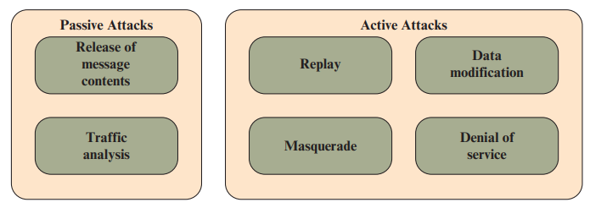
Types of Attacks
Notes:
The release of message contents is easily understood.

Slide 21
Security Service
  Enhance security of data processing systems and information transfers of an organization
  intended to counter security attacks
  using one or more security mechanisms
  often replicates functions normally associated with physical documents
    for example, have signatures, dates; need protection from disclosure, tampering, or destruction; be notarized or witnessed; be recorded or licensed
Notes:
A security service is a capability that supports one or more of the security requirements
Consider the role of a security service, and what may be required.
Note both similarities and differences with traditional paper documents, which for example:
have signatures & dates;
need protection from disclosure, tampering, or destruction;
may be notarized or witnessed;
may be recorded or licensed

Slide 22
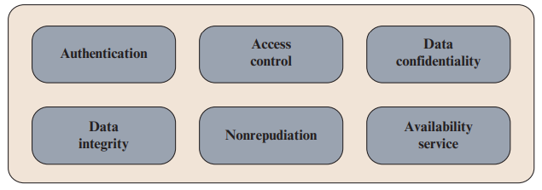
Security Services
Notes:
The authentication service is concerned with assuring that a communication is authentic.
Two specific authentication services are defined in X.800:
Peer entity authentication: Provides for the corroboration of the identity of a peer entity in an association
Data origin authentication: Provides for the corroboration of the source of a data unit. It does not provide protection against the duplication or modification of data units.
access control is the ability to limit and control the access to host systems and applications via communications links
Nonrepudiation prevents either sender or receiver from denying a transmitted message
Availability is the property of a system, or a system resource being accessible and usable upon demand by an authorized system entity, according to performance specifications for the system

Slide 23
Security Services
Authentication - assurance that the communicating entity is the one claimed
Access Control - prevention of the unauthorized use of a resource
Data Confidentiality –protection of data from unauthorized disclosure
Data Integrity - assurance that data received is as sent by an authorized entity
Non-Repudiation - protection against denial by one of the parties in a communication
Notes:
This list includes the various "classic" security services which are traditionally discussed.
Note there is a degree of ambiguity as to the meaning of these terms, and overlap in their use.
See Stallings Table 1.2 for details of the 5 Security Service categories and the 14 specific services given in X.800.

Slide 24
Security Mechanism
feature designed to detect, prevent, or recover from a security attack
no single mechanism that will support all services required
however one particular element underlies many of the security mechanisms in use:
  cryptographic techniques
Notes:
Now introduce “Security Mechanism” which are the specific means of implementing one or more security services.
Note these mechanisms span a wide range of technical components, but one aspect seen in many is the use of cryptographic techniques.

Slide 25
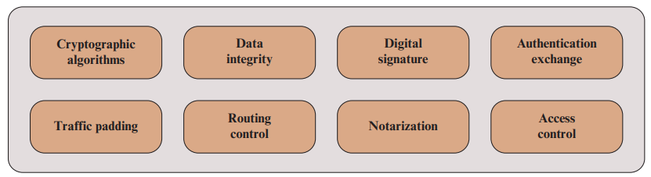
Security Mechanism
Notes:
Cryptographic algorithms: We can distinguish between reversible cryptographic mechanism and irreversible mechanism
Data integrity: This category covers a variety of mechanisms used to assure the integrity of a data unit or stream of data units. ■ Digital signature: Data appended to, or a cryptographic transformation of, a data unit that allows a recipient of the data unit to prove the source and integrity of the data unit and protect against forgery. ■ Authentication exchange: A mechanism intended to ensure the identity of an entity by means of information exchange. ■ Traffic padding: The insertion of bits into gaps in a data stream to frustrate traffic analysis attempts.
. ■ Routing control: Enables selection of particular physically or logically secure routes for certain data and allows routing changes, especially when a breach of security is suspected. ■ Notarization: The use of a trusted third party to assure certain properties of a data exchange. ■ Access control: A variety of mechanisms that enforce access rights to resources.

Slide 26
Security Mechanisms
specific security mechanisms:
  encipherment, digital signatures, access controls, data integrity, authentication exchange, traffic padding, routing control, notarization
pervasive security mechanisms:
  trusted functionality, security labels, event detection, security audit trails, security recovery
Notes:
Some examples of mechanisms from X.800. Note that the “specific security mechanisms” are protocol layer specific, whilst the “pervasive security mechanisms” are not. We will meet some of these mechanisms in much greater detail later.
See Stallings Table 1.3 for details of these mechanisms in X.800, and Table 1.4 for the relationship between services and mechanisms.

Slide 27
Cryptography
It is a branch of mathematics that deals with the transformation of data.
Cryptographic algorithms are used in many ways in information security and network security.
Cryptography is an essential component in the secure storage and transmission of data, and in the secure interaction between parties.
Notes:
Cryptography is the science of using secret codes. A cryptographer uses and studies secret codes.
A cryptanalyst, also called a code breaker or hacker, can hack secret codes and read other people’s encrypted messages.

Slide 28
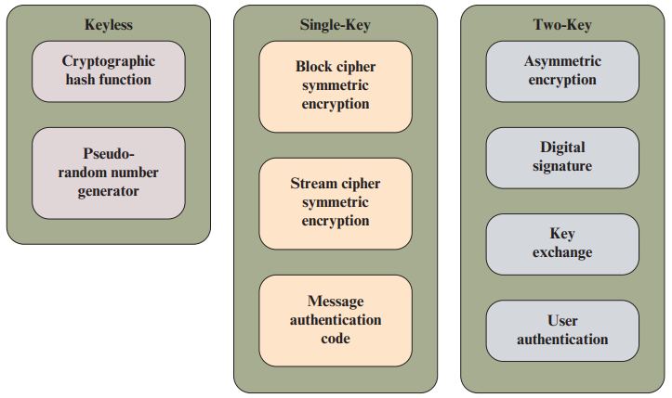
Cryptographic Algorithms
Notes:
■ Keyless: Do not use any keys during cryptographic transformations. ■ Single-key: The result of a transformation is a function of the input data and a single key, known as a secret key.
■ Two-key: At various stages of the calculation, two different but related keys are used, referred to as a private key and a public key

Slide 29
Keyless Algorithms
A cryptographic hash function is one that has additional properties that make it useful as part of another cryptographic algorithm, such as a message authentication code or a digital signature.
A pseudorandom number generator produces a deterministic sequence of numbers or bits that has the appearance of being a truly random sequence.
Notes:
A hash function turns a variable amount of text into a small, fixed-length value called a hash value, hash code, or digest.

Slide 30
Single-Key Algorithms
Block cipher: A block cipher operates on data as a sequence of blocks. A typical block size is 128 bits.
Stream cipher: A stream cipher operates on data as a sequence of bits. Typically, an exclusive-OR operation is used to produce a bit-by-bit transformation.
Message Authentication Code (MAC): A MAC is a data element associated with a data block or message.
Notes:
Single-key cryptographic algorithms depend on the use of a secret key. Encryption algorithms that use a single key are referred to as symmetric encryption algorithms
The MAC is generated by a cryptographic transformation involving a secret key and, typically, a cryptographic hash function of the message. The MAC is designed so that someone in possession of the secret key can verify the integrity of the message.

Slide 31
Two-Key Algorithms
A digital signature is a value computed with a cryptographic algorithm and associated with a data object in such a way that any recipient of the data can use the signature to verify the data’s origin and integrity.
Key exchange is the process of securely distributing a symmetric key to two or more parties.
User authentication is the process of authenticating that a user attempting to access an application or service is genuine
Notes:
Two-key algorithms involve the use of two related keys. A private key is known only to a single user or entity, whereas the corresponding public key is made available to a number of users. Encryption algorithms that use two keys are referred to as asymmetric encryption algorithms.

